Slide 1
Review: Search problem formulation
Initial state
Actions
Transition model
Goal state
Path cost
What is the optimal solution?
What is the state space?
Notes:
<number>

Slide 2
Review: Tree search
Initialize the fringe using the starting state
While the fringe is not empty
Choose a fringe node to expand according to search strategy
If the node contains the goal state, return solution
Else expand the node and add its children to the fringe
To handle repeated states:
Keep an explored set; add each node to the explored set every time you expand it
Every time you add a node to the fringe, check whether it already exists in the fringe with a higher path cost, and if yes, replace that node with the new one
Notes:
<number>

Slide 3
Search strategies
A search strategy is defined by picking the order of node expansion
Strategies are evaluated along the following dimensions:
Completeness: does it always find a solution if one exists?
Optimality: does it always find a least-cost solution?
Time complexity: number of nodes generated
Space complexity: maximum number of nodes in memory
Time and space complexity are measured in terms of
b: maximum branching factor of the search tree
d: depth of the optimal solution
m: maximum length of any path in the state space (may be infinite)
Notes:
<number>

Slide 4
Uninformed search strategies
Uninformed search strategies use only the information available in the problem definition
Breadth-first search
Uniform-cost search
Depth-first search
Iterative deepening search
Notes:
<number>

Slide 5
Breadth-first search
Expand shallowest unexpanded node
Implementation:
fringe is a FIFO queue, i.e., new successors go at end
A
B
C
D
E
F
G
Notes:
<number>

Slide 6
Breadth-first search
Expand shallowest unexpanded node
Implementation:
fringe is a FIFO queue, i.e., new successors go at end
A
B
C
D
E
F
G
Notes:
<number>

Slide 7
Breadth-first search
Expand shallowest unexpanded node
Implementation:
fringe is a FIFO queue, i.e., new successors go at end
A
B
C
D
E
F
G
Notes:
<number>

Slide 8
Breadth-first search
Expand shallowest unexpanded node
Implementation:
fringe is a FIFO queue, i.e., new successors go at end
A
B
C
D
E
F
G
Notes:
<number>

Slide 9
Breadth-first search
Expand shallowest unexpanded node
Implementation:
fringe is a FIFO queue, i.e., new successors go at end
A
B
C
D
E
F
G
Notes:
<number>

Slide 10
Properties of breadth-first search
Complete?
Yes (if branching factor b is finite)
Optimal?
Yes – if cost = 1 per step
Time?
Number of nodes in a b-ary tree of depth d: O(b^{d})
(d is the depth of the optimal solution)
Space?
O(b^{d})
Space is the bigger problem (more than time)
Notes:
<number>

Slide 11
Uniform-cost search
Expand least-cost unexpanded node
Implementation: fringe is a queue ordered by path cost (priority queue)
Equivalent to breadth-first if step costs all equal
Complete?
Yes, if step cost is greater than some positive constant ε where ε is the least step cost (we don’t want infinite sequences of steps that have a finite total cost)
Optimal?
Yes – nodes expanded in increasing order of path cost
Time?
Number of nodes with path cost ≤ cost of optimal solution (C*), O(b^{C*/ ε})
This can be greater than O(b^{d}): the search can explore long paths consisting of small steps before exploring shorter paths consisting of larger steps
Space?
O(b^{C*/ ε})
Notes:
<number>

Slide 12
Depth-first search
Expand deepest unexpanded node
Implementation:
fringe = LIFO queue, i.e., put successors at front
A
B
C
D
E
F
G
Notes:
<number>

Slide 13
Depth-first search
Expand deepest unexpanded node
Implementation:
fringe = LIFO queue, i.e., put successors at front
A
B
C
D
E
F
G
Notes:
<number>

Slide 14
Depth-first search
Expand deepest unexpanded node
Implementation:
fringe = LIFO queue, i.e., put successors at front
A
B
C
D
E
F
G
Notes:
<number>

Slide 15
Depth-first search
Expand deepest unexpanded node
Implementation:
fringe = LIFO queue, i.e., put successors at front
A
B
C
D
E
F
G
Notes:
<number>

Slide 16
Depth-first search
Expand deepest unexpanded node
Implementation:
fringe = LIFO queue, i.e., put successors at front
A
B
C
D
E
F
G
Notes:
<number>

Slide 17
Depth-first search
Expand deepest unexpanded node
Implementation:
fringe = LIFO queue, i.e., put successors at front
A
B
C
D
E
F
G
Notes:
<number>

Slide 18
Depth-first search
Expand deepest unexpanded node
Implementation:
fringe = LIFO queue, i.e., put successors at front
A
B
C
D
E
F
G
Notes:
<number>

Slide 19
Depth-first search
Expand deepest unexpanded node
Implementation:
fringe = LIFO queue, i.e., put successors at front
A
B
C
D
E
F
G
Notes:
<number>

Slide 20
Depth-first search
Expand deepest unexpanded node
Implementation:
fringe = LIFO queue, i.e., put successors at front
A
B
C
D
E
F
G
Notes:
<number>

Slide 21
Properties of depth-first search
Complete?
Fails in infinite-depth spaces, spaces with loops
Modify to avoid repeated states along path
→ complete in finite spaces
Optimal?
No – returns the first solution it finds
Time?
Could be the time to reach a solution at maximum depth m: O(b^{m})
Terrible if m is much larger than d
But if there are lots of solutions, may be much faster than BFS
Space?
O(bm), i.e., linear space!
Notes:
<number>

Slide 22
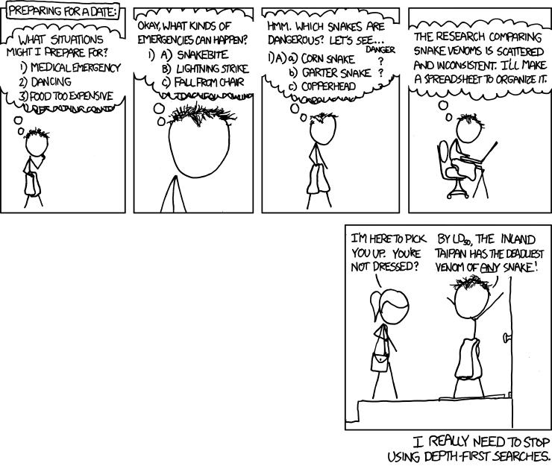
Notes:
<number>

Slide 23
Iterative deepening search
Use DFS as a subroutine
Check the root
Do a DFS searching for a path of length 1
If there is no path of length 1, do a DFS searching for a path of length 2
If there is no path of length 2, do a DFS searching for a path of length 3…
Notes:
<number>

Slide 24
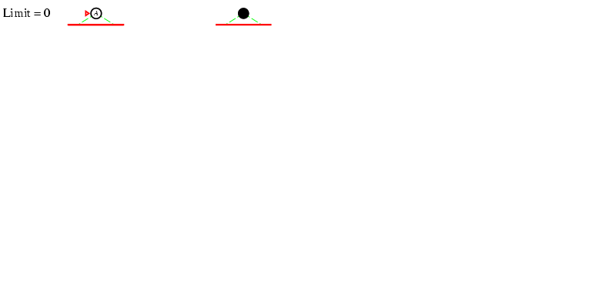
Iterative deepening search
Notes:
<number>

Slide 25
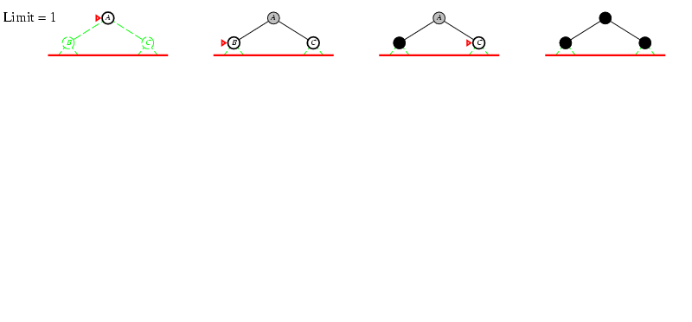
Iterative deepening search
Notes:
<number>

Slide 26
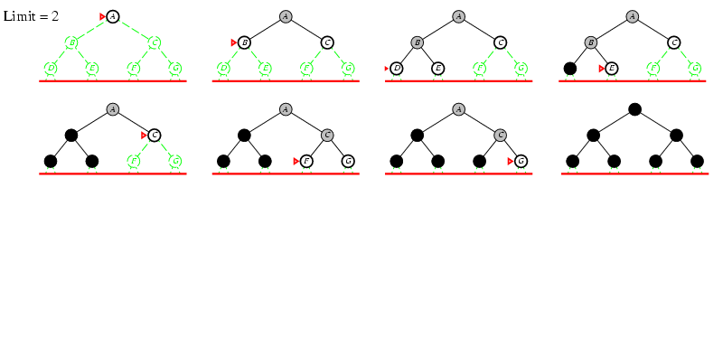
Iterative deepening search
Unexplored State Space
Fringe Nodes in white
Expanded nodes in grey
Deleted nodes in black
Notes:
<number>

Slide 27
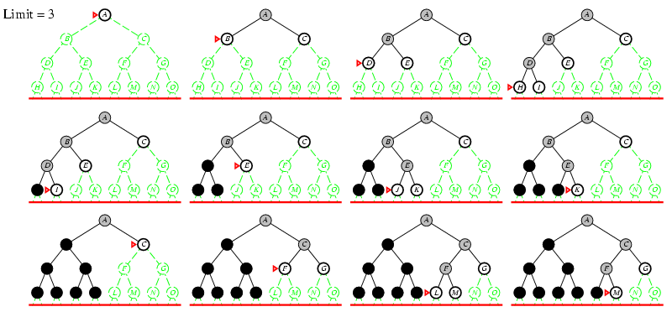
Iterative deepening search
Notes:
<number>

Slide 28
Properties of iterative deepening search
Complete?
Yes
Optimal?
Yes, if step cost = 1
Time?
(d+1)b⁰ + d b¹ + (d-1)b² + … + b^{d} = O(b^{d})
Space?
O(bd)
Notes:
<number>

